Slide 1


JavaScript chapter-2

Slide 2
Contents
JavaScript Array
JavaScript Loop
JavaScript DOM Manipulation

Slide 3




JavaScript-Arrays
JavaScript array is an object that represents a collection of similar type of elements.
3 ways to construct array in JavaScript
By array literal
By creating instance of Array directly (using new keyword)
By using an Array constructor (using new keyword)

Slide 4


JavaScript array literal
var arrayname=[value1,value2.....valueN];
<script>
Var job=[“UI Designer",“Data Analyst",“.NetDeveloper"];
Console.log(“job");
}
</script>
UIDesigner DataAnalyst .NetDeveloper

Slide 5
JavaScript Array directly
new keyword is used to create instance of array.
var arrayname=new Array();
var job = new Array();
job[0] = " UI Designer ";
job[1] = " DataAnalyst";
job[2] = " .NetDeveloper ";
Console.log(job);
}
UI Designer DataAnalyst NetDeveloper

Slide 6
JavaScript Array Constructor
To create instance of array by passing arguments in constructor so that we don't have to provide value explicitly.
<script>
var job=new Array(“UI Designer",“DataAnalyst",“.NetDeveloper");
Console.log(job);
}
</script>
UI Designer DataAnalyst . NetDeveloper

Slide 7

JavaScript Array Methods
Methods | Description
push() | It adds one or more elements to the end of an array.
pop() | It removes and returns the last element of an array.
indexOf() | It searches the specified element in the given array and returns the index of the first match.
lastIndexOf() | It searches the specified element in the given array and returns the index of the last match.
splice() | It add/remove elements to/from the given array.

Slide 8

JavaScript Loops
The loops are used to iterate the piece of code using for, while, do while or for-in loops.
Types of loops
while loop
Do-while loop
For loop
For-in loop

Slide 9

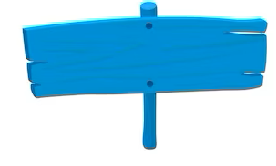
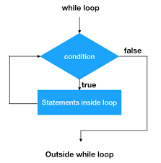
JavaScript While Loops
The while loop iterates the elements for the infinite number of times.
while (condition)
{
code to be executed
}

Slide 10
JavaScript While Loops
const salaries = [50000, 60000, 75000, 80000, 90000];
let sum = 0;
let index = 0;
while (index < salaries.length) {
sum += salaries[index];
index++;
} document.write(sum);

Slide 11

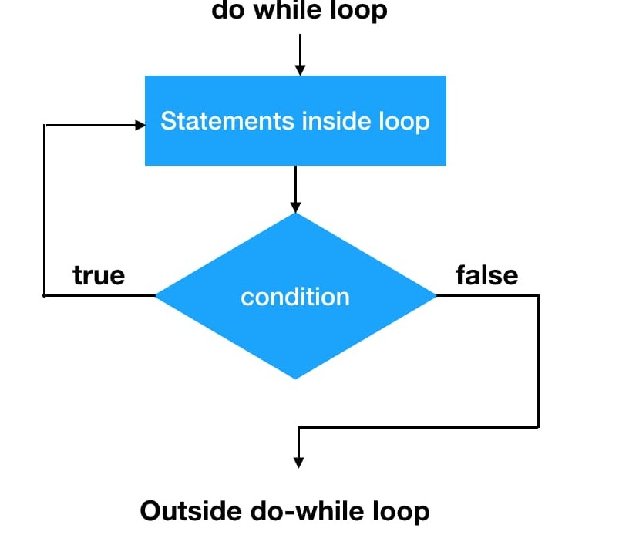
JavaScript Do-While Loops
The JavaScript do while loop iterates the elements for the infinite number of times like while loop. But, code is executed at least once whether condition is true or false.
do{
code to be executed
}while (condition);

Slide 12
JavaScript Do-While Loops
let userInput;
let isValidEmail = false;
do {
userInput = prompt("Please enter your email address:");
if (isValidEmailFormat(userInput)) {
isValidEmail = true;
}
else {
alert("Invalid email format. Please try again.");
}
} while (!isValidEmail);
console.log(`Thank you for providing a valid email:${userInput}`);

Slide 13

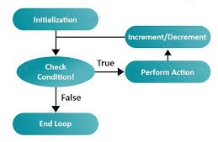
JavaScript For Loops
The JavaScript for loop iterates the elements for the fixed number of times.
for (initialization; condition; increment)
{
code to be executed
}

Slide 14
JavaScript For Loops
const salaries = [40000, 50000, 60000, 75000];
let totalSalary = 0;
for (let i = 0; i < salaries.length; i++) {
totalSalary += salaries[i];
}
Document.write(totalSalary);

Slide 15

JavaScript For-in Loops
The JavaScript for in loop is used to iterate the properties of an object.
The code in the body of the for...in loop is executed once for each property.
for (key in object)
{ code to be executed
}

Slide 16
JavaScript For-in Loops
const job = {
title: "Software Engineer",
company: "TechCo",
location: "San Francisco",
salary: 100000,
};
for (const key in job) {
console.log(key + ": " + job[key]);
}

Slide 17
JavaScript DOM Manipulations
The DOM is a W3C (World Wide Web Consortium) standard.
The DOM defines a standard for accessing documents
The HTML DOM is a standard object model and programming interface for HTML. It defines:
The HTML elements as objects
The properties of all HTML elements
The methods to access all HTML elements
The events for all HTML elements
The HTML DOM is a standard for how to get, change, add, or delete HTML elements.

Slide 18
Javascript DOM Manipulations
Finding HTML Elements
Property | Description
document.getElementById(id) | Find an element by element id
document.getElementsByClassName(name) | Find elements by class name
Method | Description
element.setAttribute(attribute, value) | Change the attribute value of an HTML element

Slide 19
Javascript DOM Manipulations
Changing HTML Elements
Methods | Description
element.innerHTML = new html content | Change the inner HTML of an element
element.attribute = new value | Change the attribute value of an HTML element
element.style.property = new style | Change the style of an HTML element

Slide 20
Javascript DOM Manipulations
Adding and Deleting Elements
Method | Description
document.createElement(element) | Create an HTML element
document.removeChild(element) | Remove an HTML element
document.appendChild(element) | Add an HTML element
document.replaceChild(new, old) | Replace an HTML element
document.write(text) | Write into the HTML output stream

Slide 21

What We Discussed?
JavaScript Array
JavaScript Loop
JavaScript DOM Manipulation

Slide 22

Questions?

